Slide 1
CH4: Forces and Newton's Laws of Motion
Concepts of force, mass, and weight.
Newton’s laws of motion.
Newton’s law of gravitation.
Friction: kinetic and static frictional forces
Free-body-diagram: Identifying forces acting on an object

Slide 2
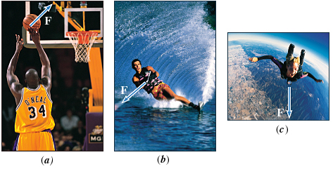
The Concept of Force
In common usage, a force is a push or a pull.
Forces can be categorized as,
Contact forces and Non-Contact forces.

Slide 3
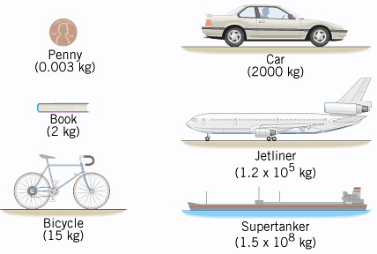
Mass
Mass is a measure of the amount of matter contained in an object.
Mass is a scalar quantity.

Slide 4
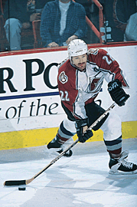
Newton's First Law Of Motion
An object continues in a state of rest or in a state of motion at a constant speed along a straight line, unless compelled to change that state by a net force.
The net force is the vector sum of all of the forces acting on the object.
Inertia is the natural tendency of an object to remain at rest or in motion at a constant speed along a straight line.
The mass of an object is a quantitative measure of inertia.

Slide 5
Net Force
The net force on an object is the vector sum of all forces acting on that object.
Individual Forces
Net Force
4 N
10 N
6 N

Slide 6
Net Force
Individual Forces
Net Force
5 N
3 N
4 N

Slide 7
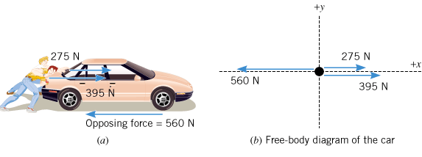
Pushing a Stalled Car

Slide 8
Net Force
Mathematically, the net force is
written as
where the Greek letter sigma denotes the vector sum.

Slide 9
Newton's Second Law of Motion
Newton’s second law is a relationship between acceleration, forces, and mass.
When a net external force acts on an object of mass m, the acceleration a that results is directly proportional to the net force and has a magnitude that is inversely proportional to the mass. The direction of the acceleration is the same as the direction of the net force.
SI Unit of Force: : kg · m/s² = newton (N)

Slide 10
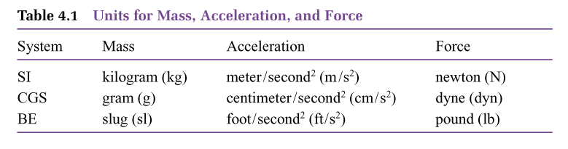
Units

Slide 11
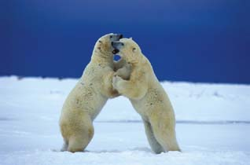
Newton's Third Law of Motion
Whenever one body exerts a force on a second body, the second body exerts an oppositely directed force of equal magnitude on the first body.

Slide 12
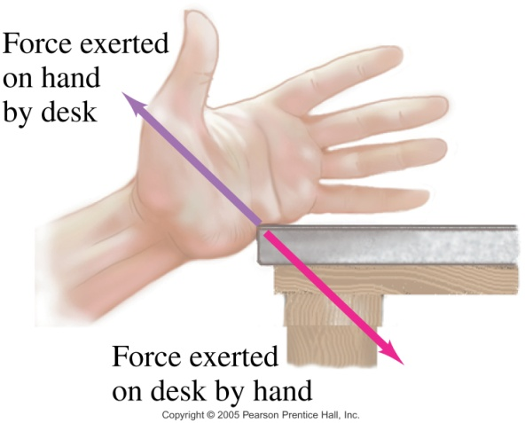
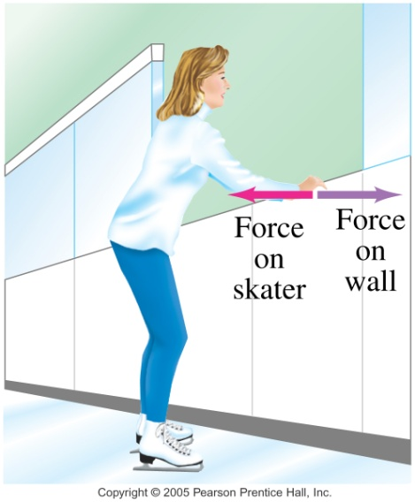
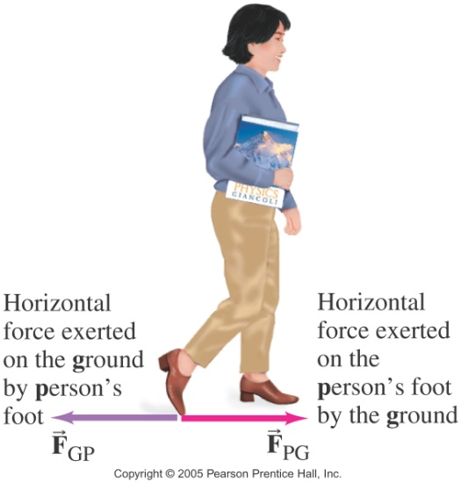
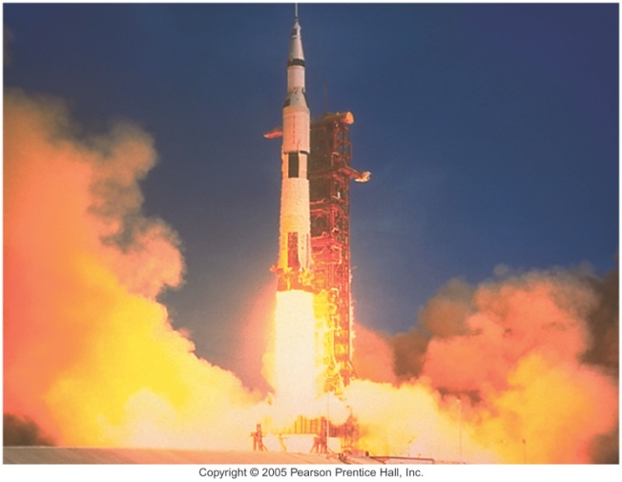
Examples of Newton's 3rd Law

Slide 13
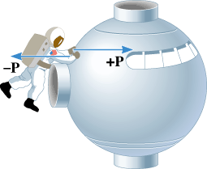
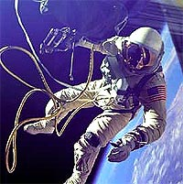
Example
Suppose that the mass of the spacecraft in Figure 4.7 is mS = 11 000 kg and that the mass of the astronaut is mA = 92 kg. In addition, assume that the astronaut exerts a force of P = +36 N on the spacecraft. Find the accelerations of the spacecraft and the astronaut.
Astronauts use a tether to stay connected to the space capsule.

